Slide 1
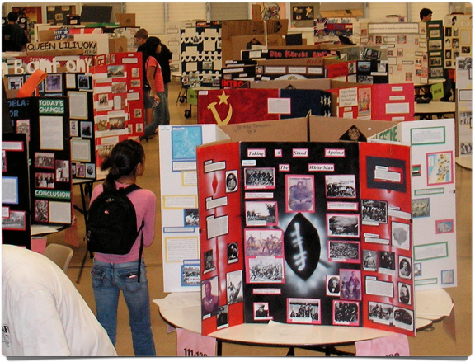
National History Day®
EXHIBITS

Slide 2
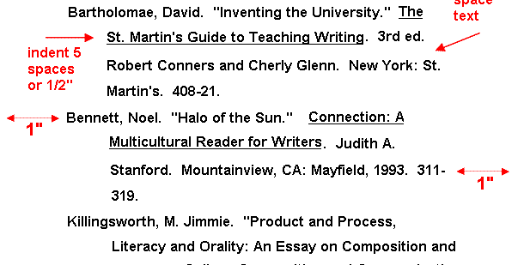
DOCUMENTATION
Paper work required for ALL projects

Slide 3
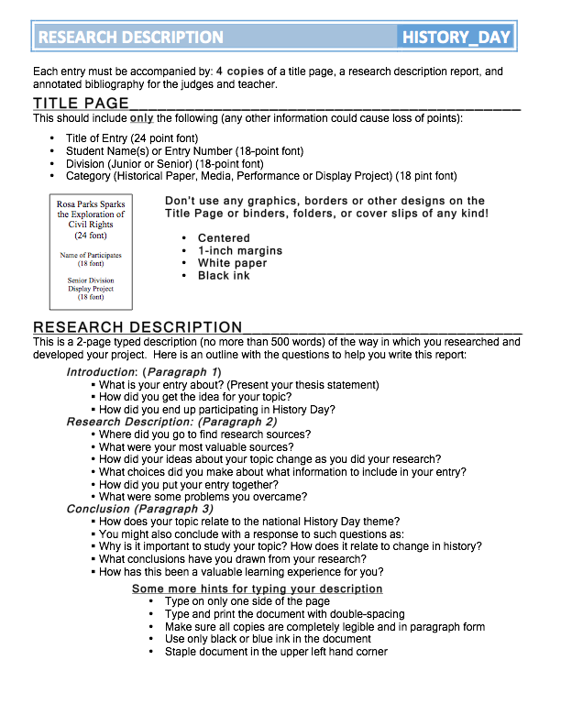
Research Description aka Process Paper
A 2-page typed description (no more than 500 words) of the way in which you researched and developed your project.
‹#›

Slide 4
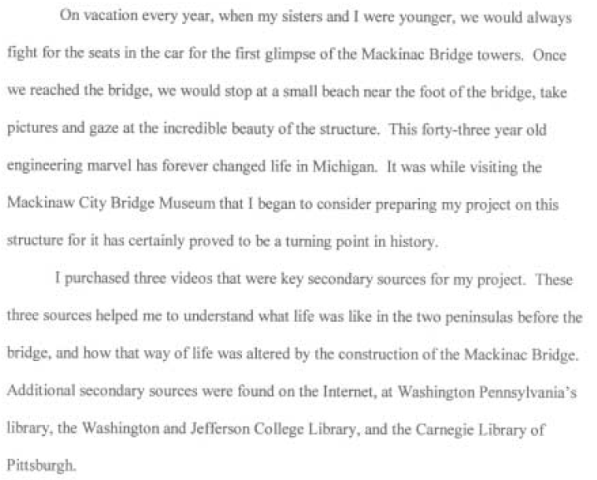
‹#›
‹#›

Slide 5
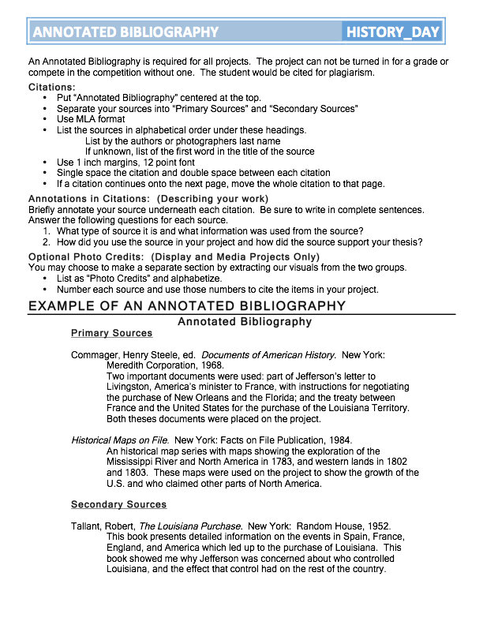
Annotated Bibliography
Separate your sources into “Primary Sources” and “Secondary Sources”
Use MLA format
Briefly annotate your source underneath each citation.
‹#›

Slide 6
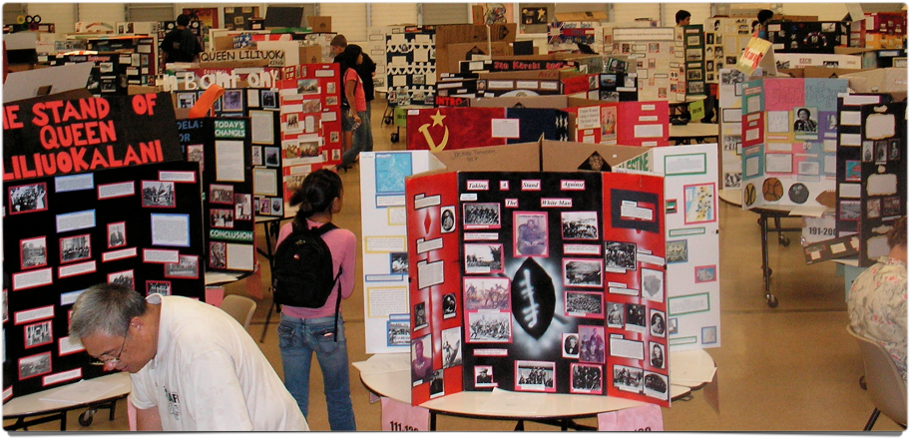
DISPLAY BOARDS

Slide 7
1. TEXT (Analysis Statements & Quotes)
All of the words on your display:
excluding primary source evidence

Slide 8
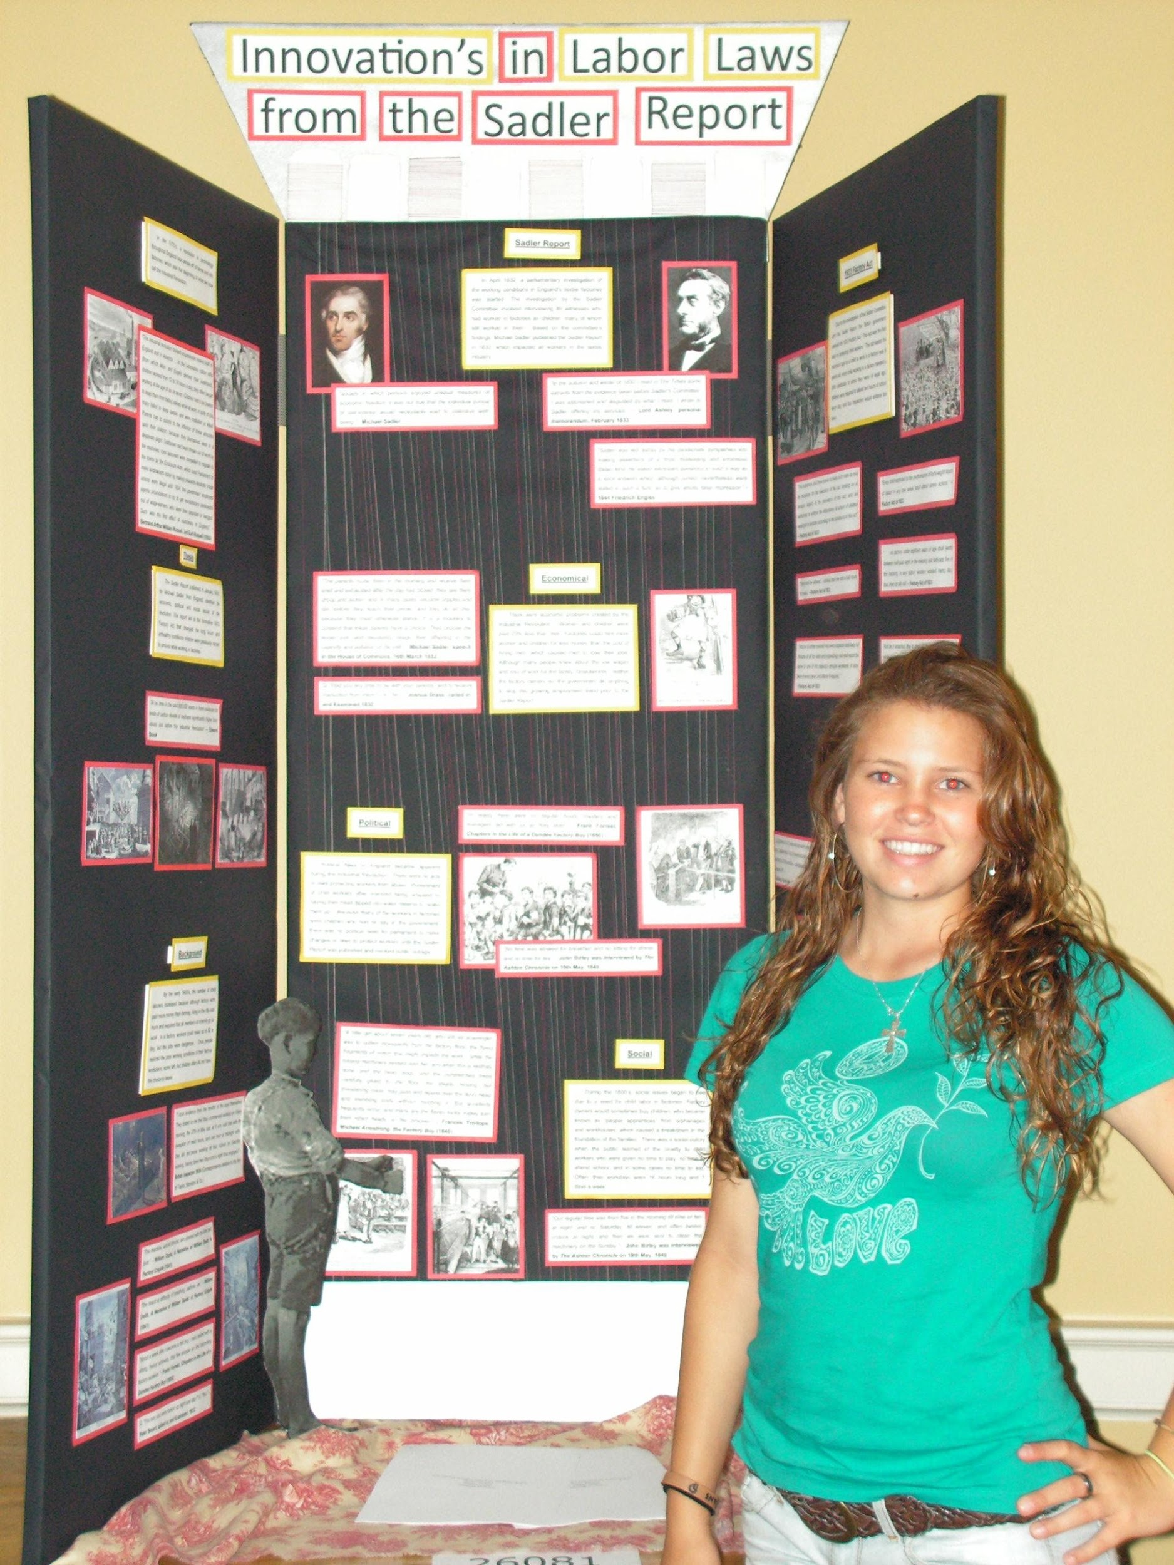
Title
A title is a description of the topic in relation to the year’s theme.
90 spaces limitation for lettering
Included as part of the word count
‹#›

Slide 9
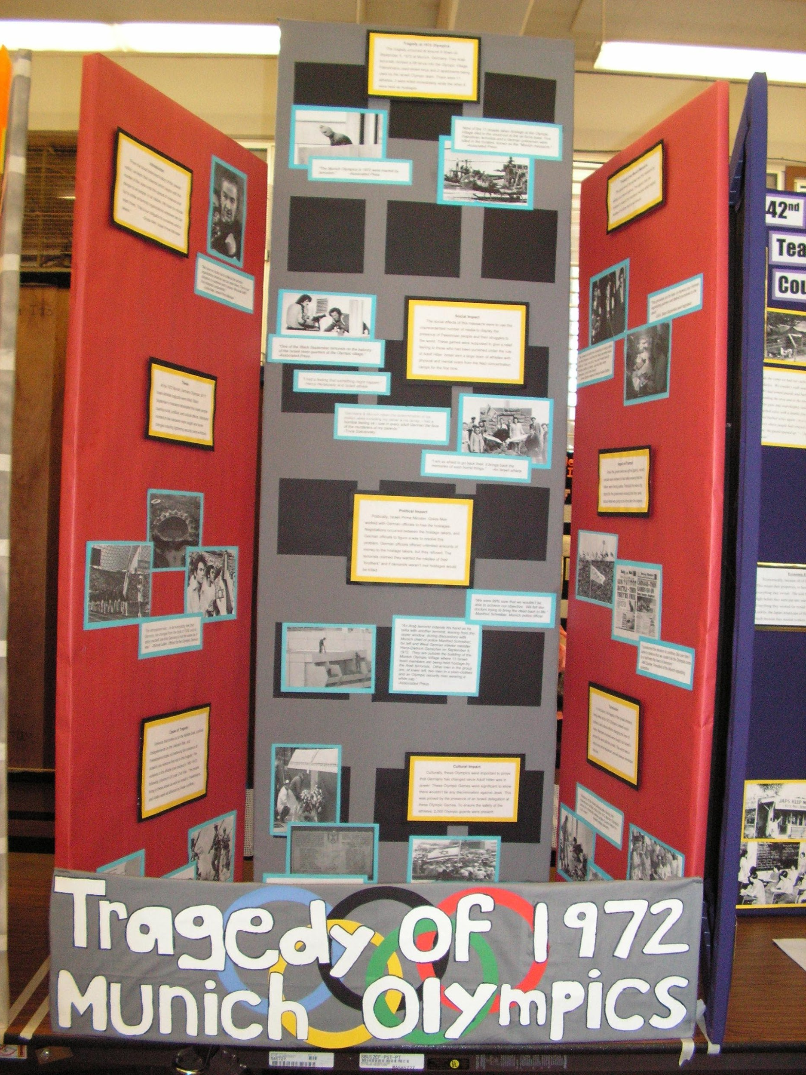
Analysis Statements
These short word sections explaining your interpretation of the information: rather than just a description of the events.
Thesis
History Context
Topic (Stand)
Action #1
Action #2
Action #3
Change Over Time
Conclusion
‹#›

Slide 10
Introduction
INTRODUCTION
Content: Give the 5Ws of the topic. Write as if the reader has no understanding of your topic. Explain time and place, where and who, and what happened and why. Hint 1: To save for the word count, you can substitute a quote for the text of the introduction.
Give the 5w’s of the topic.
Write as if the reader has no understanding of you topic. Explain time and place, where and who, what happened and why.
‹#›

Slide 11
Thesis
THESIS
Content: Describe what you’re going to prove. The thesis needs to explain how the topic relates to the years’ theme, time and place, cause and effect, change over time, and impact and significance. It draws conclusions about how the topic affects individuals, communities, nations, or the world. Hint 2: Format to save space. Use .5 margins and space at 1.5.
Description of what you’re going to prove.
Needs to explain how the topic relates to the years’ theme, time and place
Cause and effect
Change over time
Impact and significance.
It draws conclusions about how the topic affected individuals, communities, nations, or the world.
‹#›

Slide 12
Cause
What key events happened before in history which were influential to the topic.
List the factual information in chronological order.
Key people, events, and/or ideas
CAUSE
Content: What key people, events, and ideas happened before in history, which influenced and/or caused the topic. List factual information in chronological order. Hint 3: Font is everything. Use 18 pt plain font so it is easy to read.
‹#›

Slide 13
Topic
What happened at the time. (5W’s)
Describe what your topic is about.
What was the outcome?
TOPIC
Content: Given the 5Ws of the conflict. Describe who was involved and what key events occurred during the conflict. Who was impacted? Hint 4: Use headers for each analysis statement show the section supports the thesis. Make them 22 pt font, bold, and underline each.
‹#›

Slide 14
Action #1 Action #2 Action #3
Impact
Content: Describe one of the impacts of the topic. For example, focus on one of the parts of SPICE such as social, political, intellectual, cultural, economic or others such as technological, environmental, religious, etc… Hint 5: Every sentence of the analysis must support the thesis or eliminate it.
Describe the impact as a result of the event.
Focus on 1 of the parts of SPICE
Keep in mind both sides of the story
‹#›

Slide 15
Change
CHANGES
Content: Explain how the compromise changed a community, nation, or the world afterwards. Focus on the impacts of the conflict that you presented earlier. After your first sentence stating the change, use a sentence showing change from the earlier impacts.
Hint 9: Also consider justifying the text to give you clean lines.
What changes occurred afterwards?
Give 3 examples for how things were never the same again.
‹#›

Slide 16
Conclusion
Summary of what was proven by the project.
Give detail on the reactions
Explain the impact and significance topic had on community, nation, or world.
CONCLUSION
Content: An explanation of what was proven throughout the project. Focus on the changes that occurred. Explain how the topic has had a significant impact in history and on a particular group.
‹#›

Slide 17
FONT & SIZE
Text count includes all of your own words: title, headers, analysis statements, timeline.
Mount in 18 pt font, plain text
1.5 spaced
Bold & underline title

Slide 18
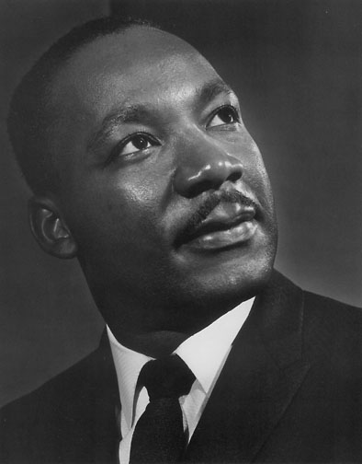
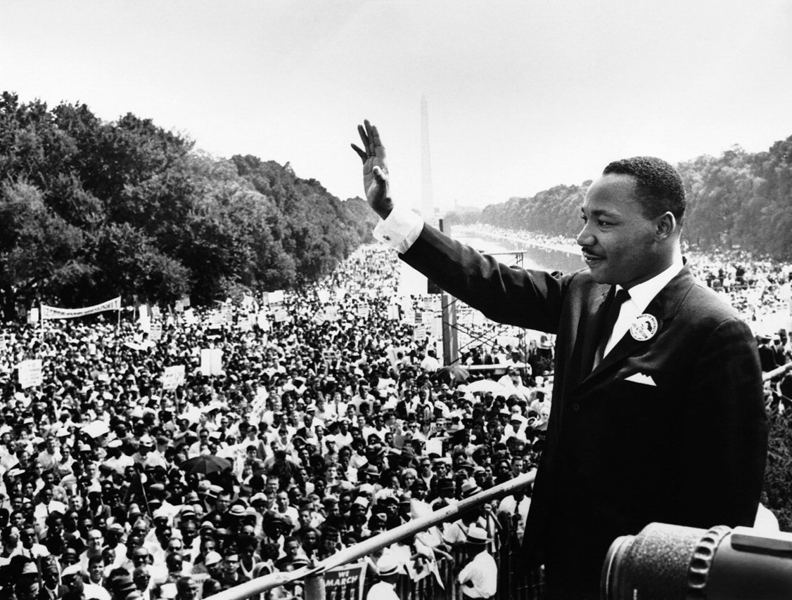
Word Limit
Word limit for text is 500 words. (2 pages, typed, single space, 12pt font.)
Words not counted: quotes from other people, documents (newspapers, letters…)
NO CAPTIONS, do not label what the picture is about. Ex. “This is a picture of Martin Luther King Jr.
X
This is a picture of Martin Luther King Jr.
“I have a dream…”
(Martin Luther King Jr.,
Civil Rights Leader, 1963)
‹#›

Slide 19
2. VISUAL EVIDENCE
Primary source visual explaining the story.

Slide 20
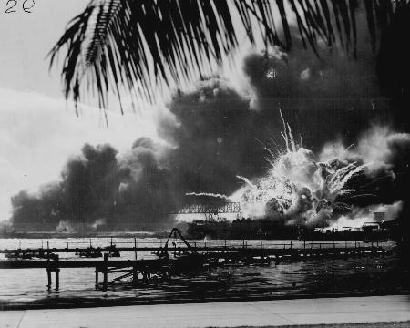
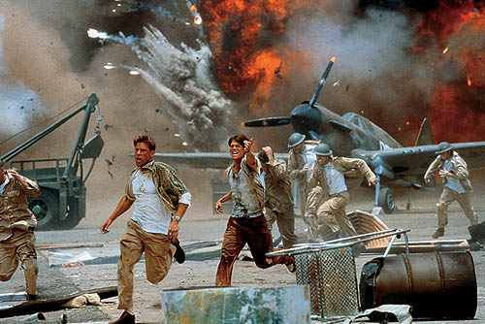
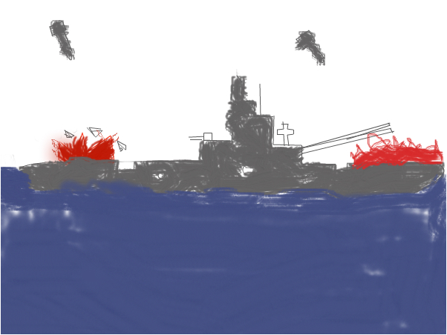
Photographs
Action pictures only
No recreations allowed unless ancient history.
Size requirements: stay within the 3’by5’ or 4’by6’ range for each photo.
No 5’7’ or 8’10’ sizes. Large pictures cause the board to look cluttered, small picture are hard to understand.
‹#›

Slide 21
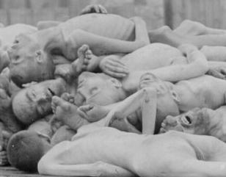
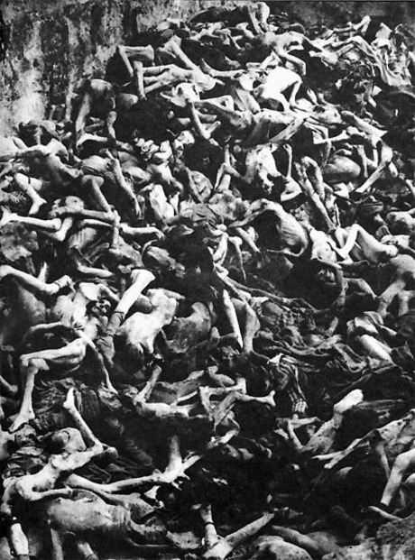
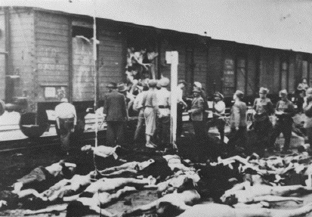
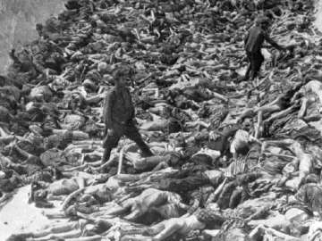
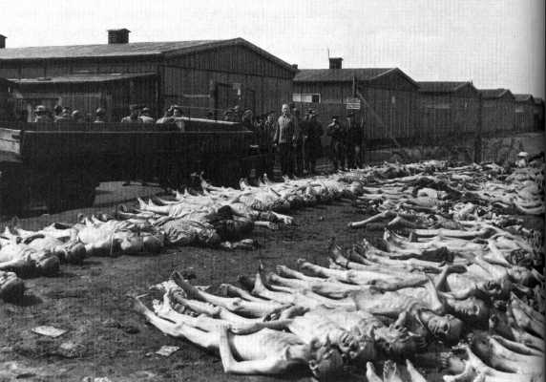
Photographs
Eliminate duplicate photos. Choose the best photo to get the point across.
Explicit photos or inappropriate photos must be approved by the teacher or administration.
‹#›

Slide 22
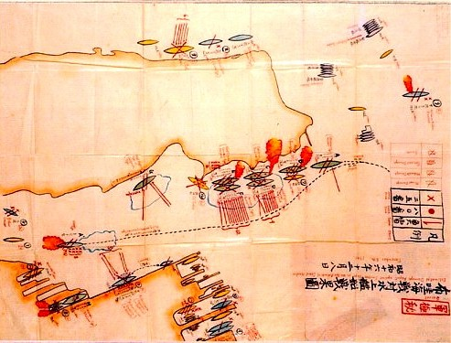
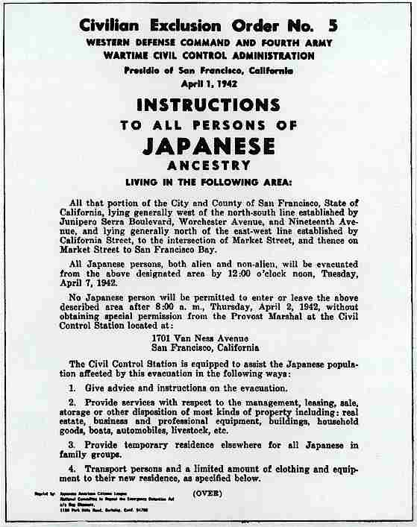
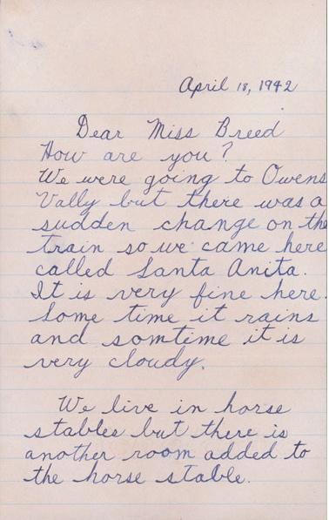
Documents
All documents such as: newspaper clippings, maps, graphs, charts, letters, pamphlets, brochures
May be used in full or photocopied for partial use.
‹#›

Slide 23
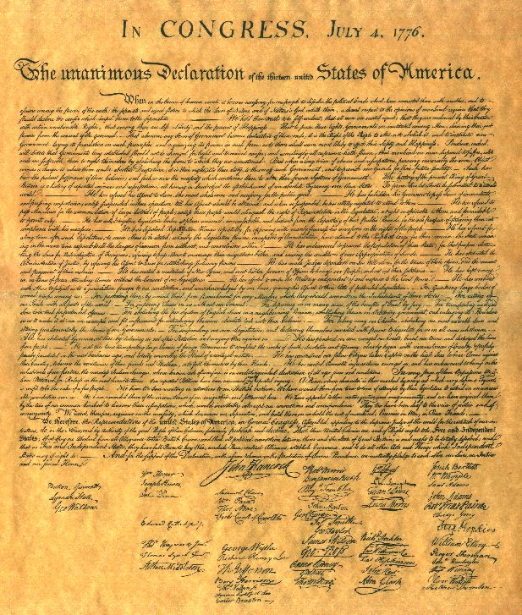
Citing Documents
A portion must be highlighted to draw attention to the facts.
Illegible written documents may include a transcription with proper citation.
Quotations of interviews and documents must include cited information such as the speaker or writer, position or who they represent, the document, and date in available.
“We hold these truths to be self-evident, that all men are created equal, that they are endowed by their Creator with certain unalienable Rights, that among these are Life, Liberty and the pursuit of Happiness.”
(U.S Declaration of Independence, 1776)
‹#›

Slide 24
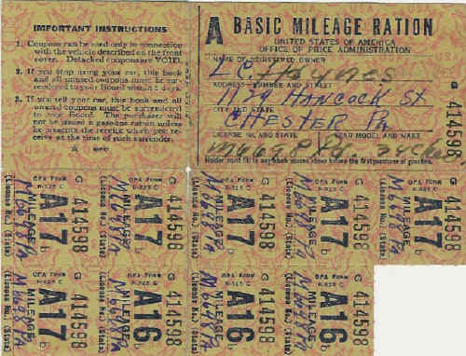
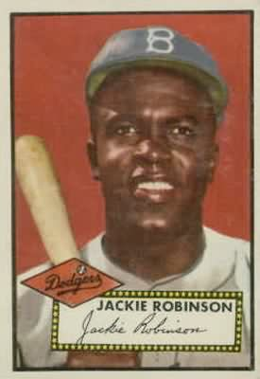
Artifacts
Artifacts must be historically accurate and labeled with subject and donor identified.
Each item must be securely attached to the project to prevent theft.
‹#›

Slide 25
Media Devices
Tape recorders & video monitors must not run for more than 3 minutes.
Viewers and judges must be able to control start and end.
NOT ALLOWED AT SCHOOL FAIR
‹#›

Slide 26
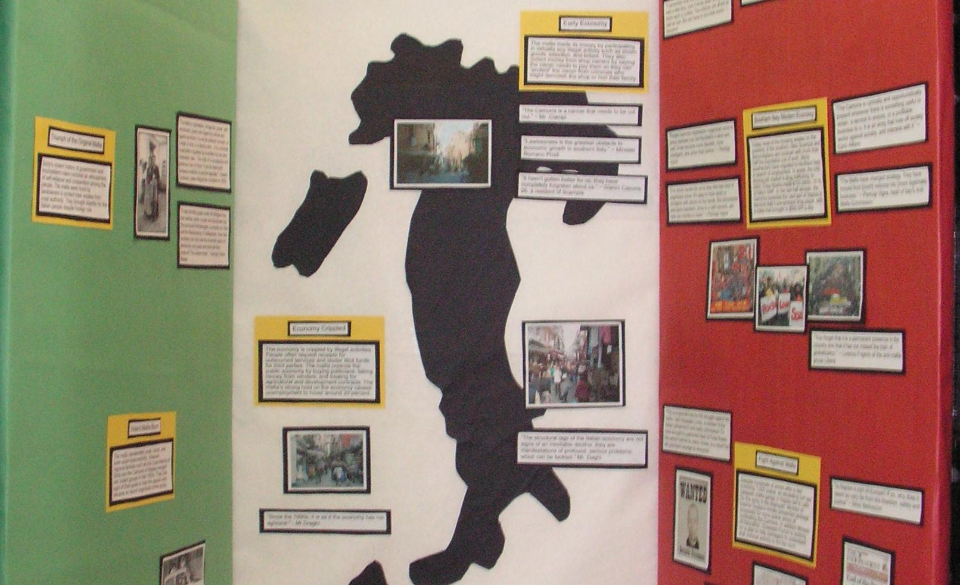
3. LAYOUT
Telling the story in order through words and visuals.

Slide 27
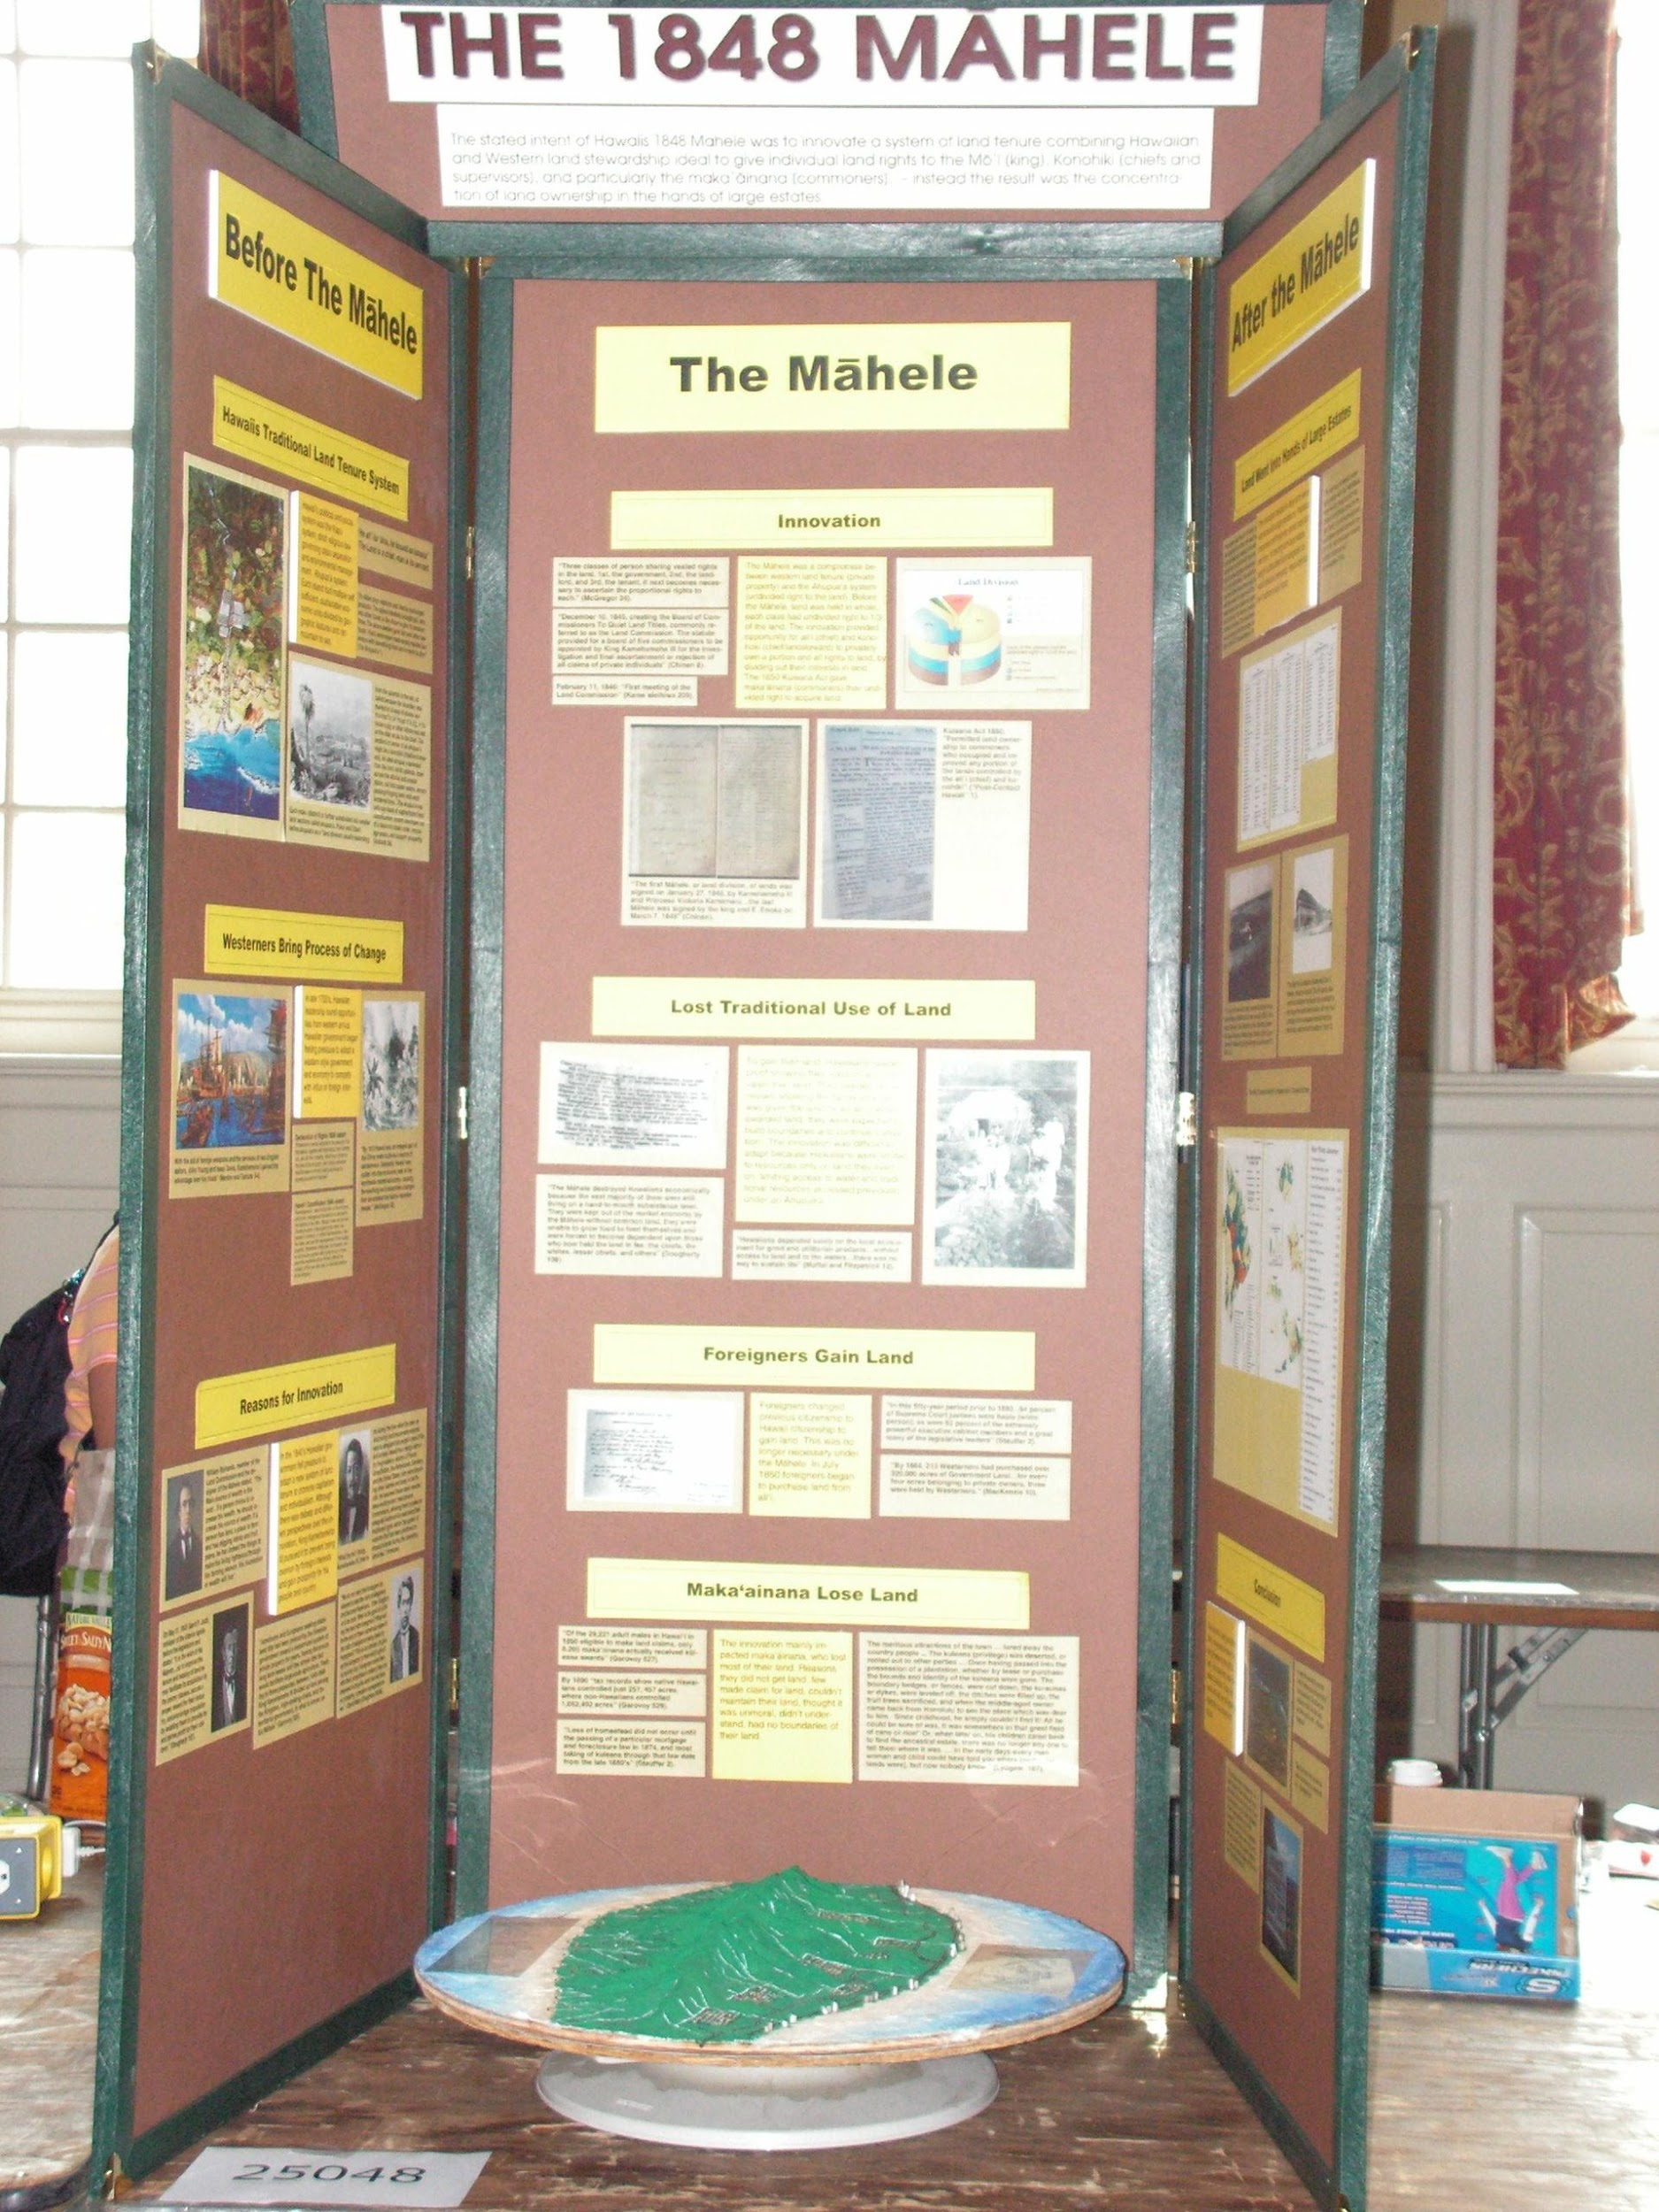
Reading Direction
Organize the material on the display so that it reads like a book.
Breaks between subjects.
Introduction should start on the top left-hand corner and the conclusion will end up at the bottom right-hand corner.
‹#›

Slide 28
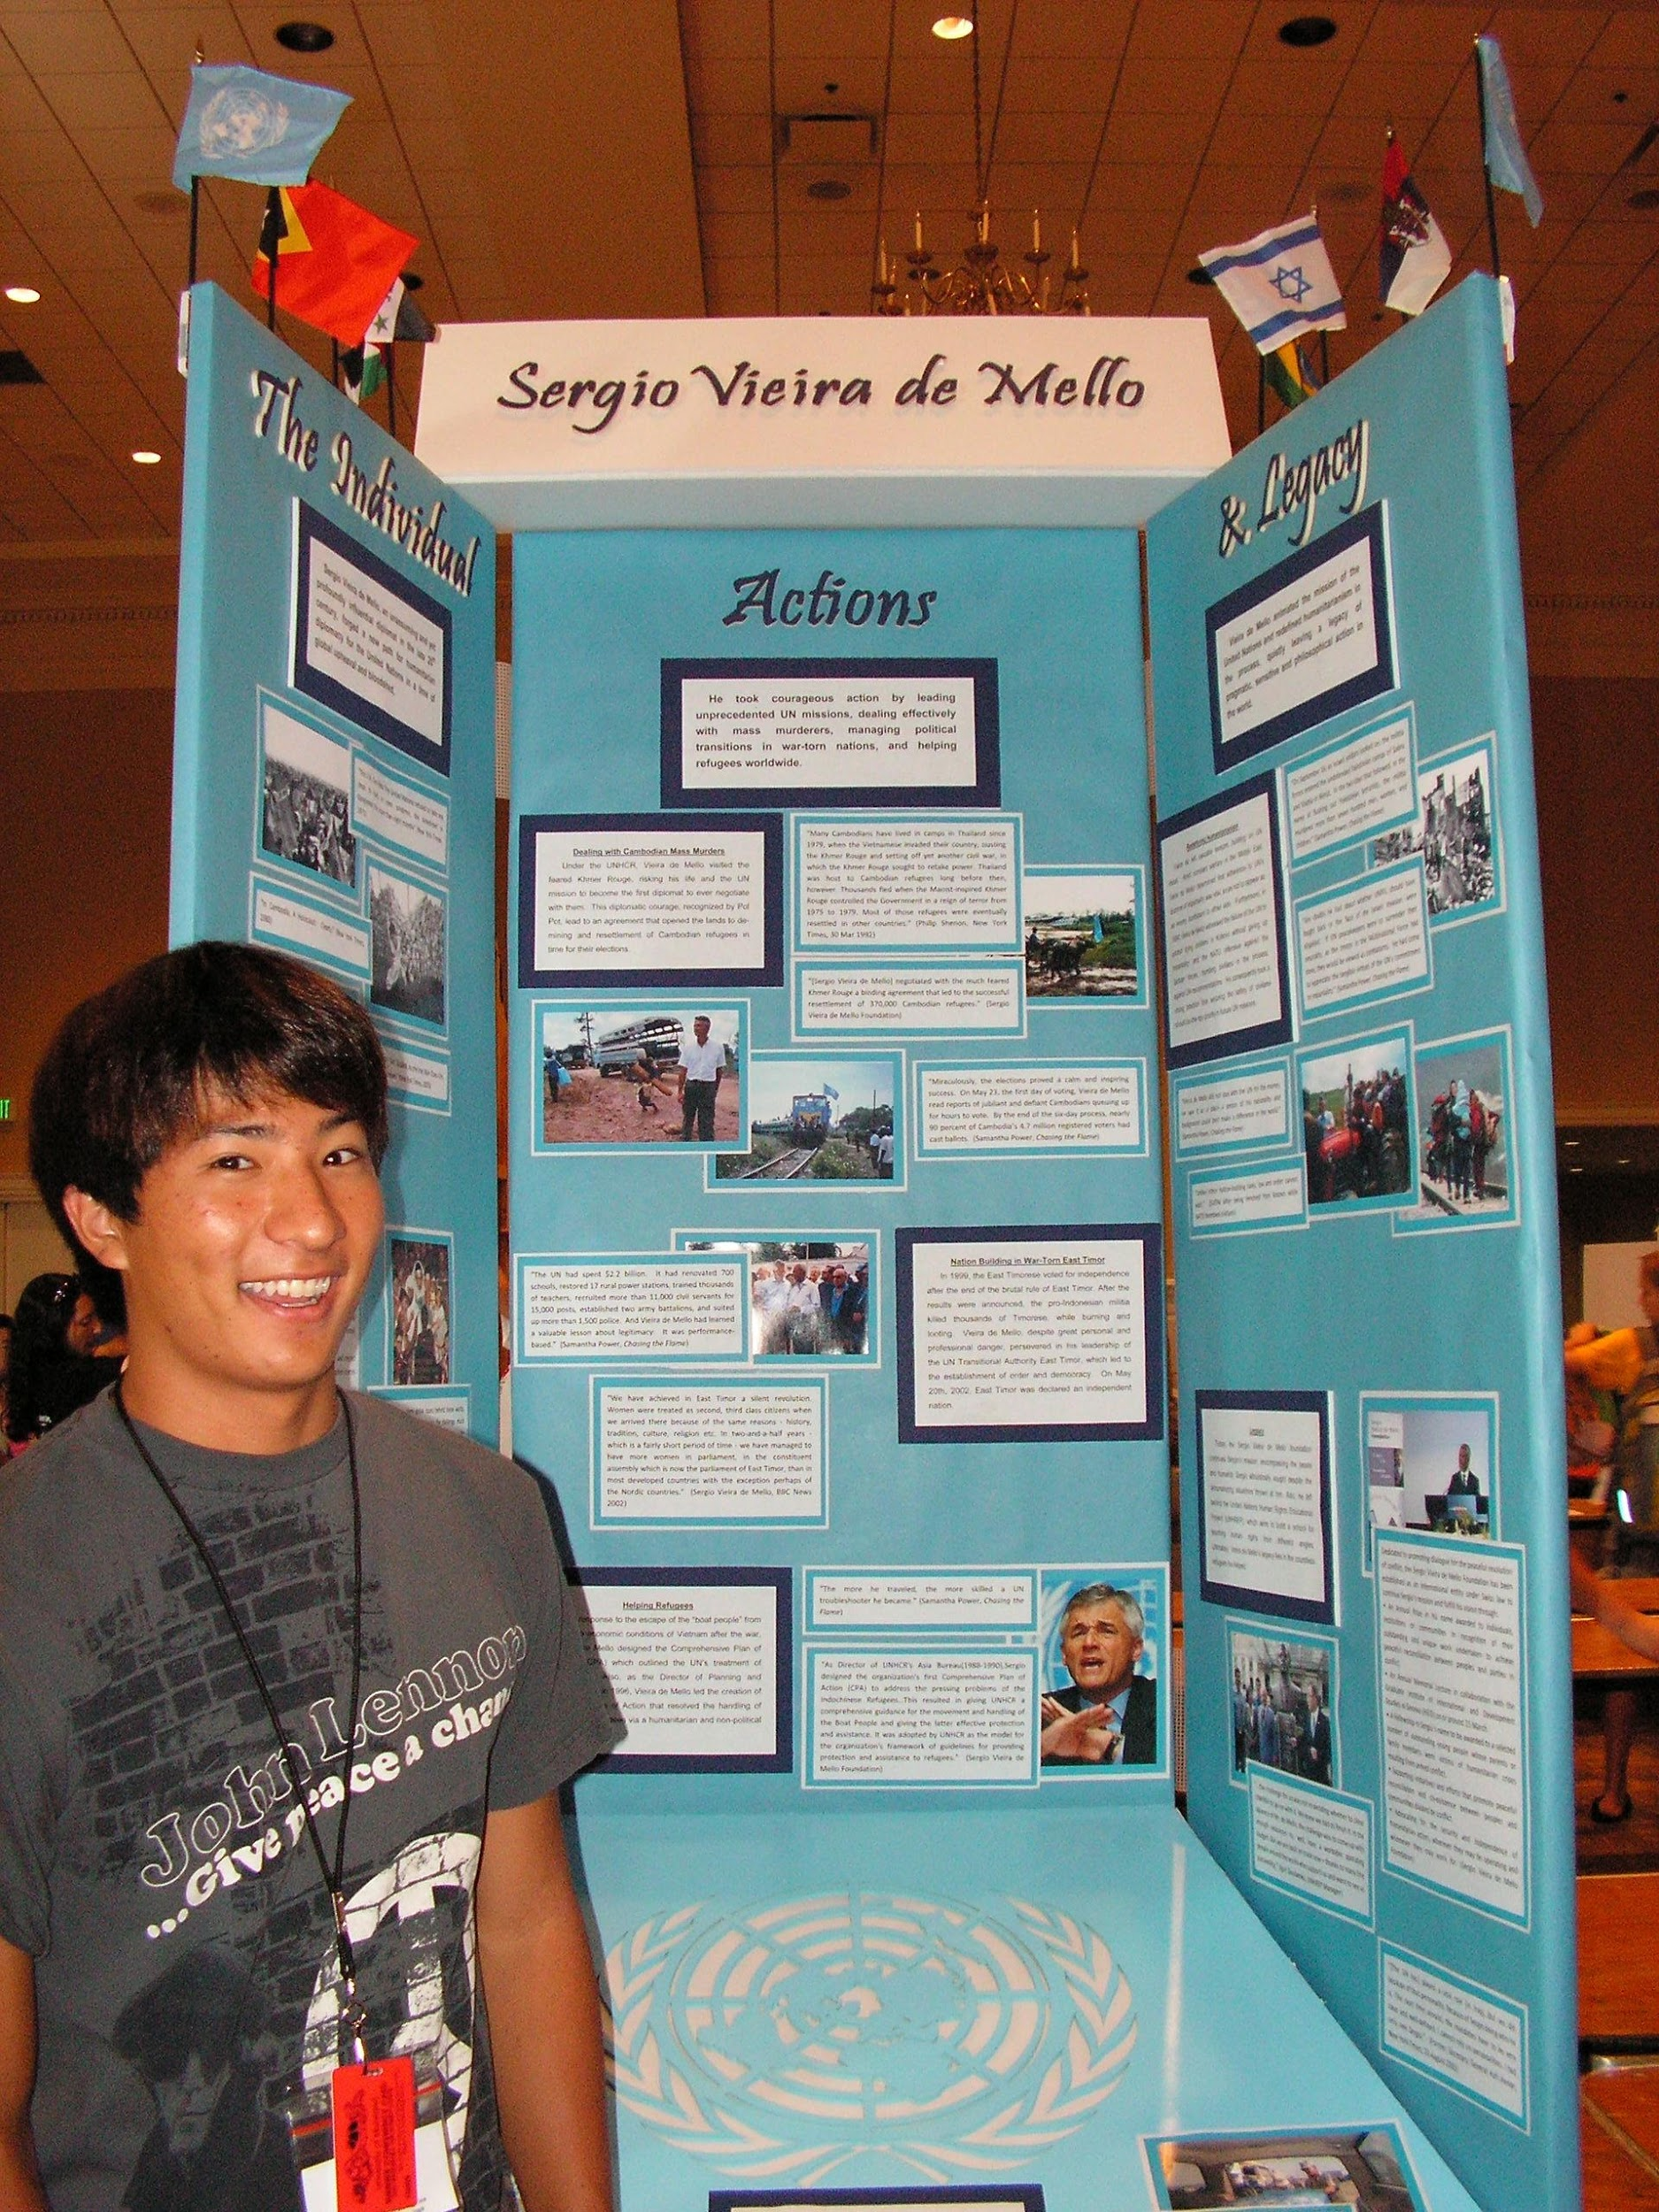
Themed Panels
Divide panels into three sections in relation to the theme.
Panel #1: Before (Cause)
Panel #2: During (Then)
Panel #3: Change (Effect)
‹#›

Slide 29
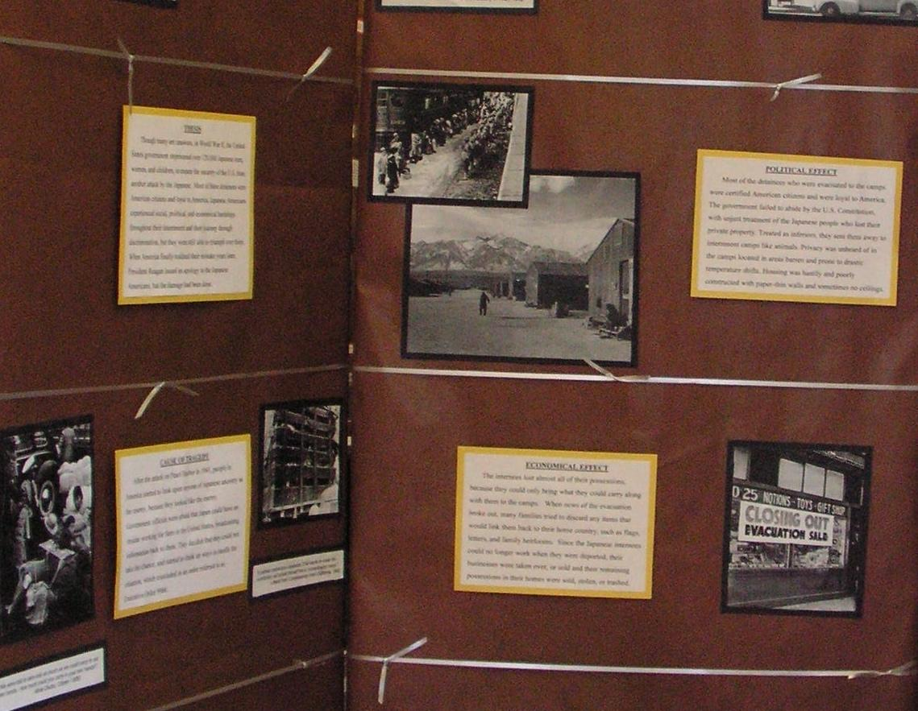
Analysis Statements
Analysis statements should have clear titles.
Bold, underline.
Back with same, unique color that stands out the most.
‹#›

Slide 30
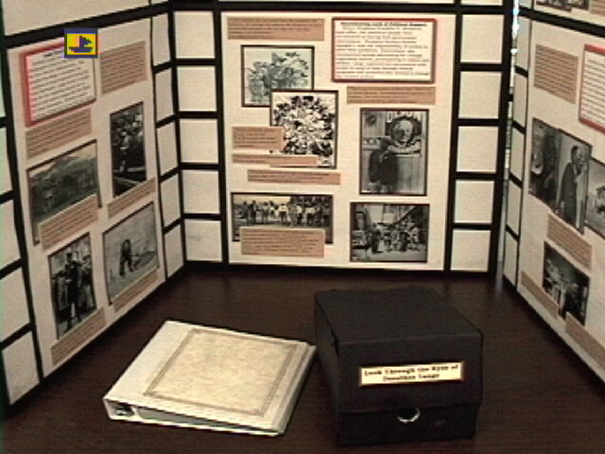
Evidence
At least 3 pieces of evidence for each analysis statements.
Visuals should show evidence of each point of the analysis statement
All evidence should be on the same color, different from the analysis statements.
Group with statements, can overlap to tell story.
‹#›

Slide 31
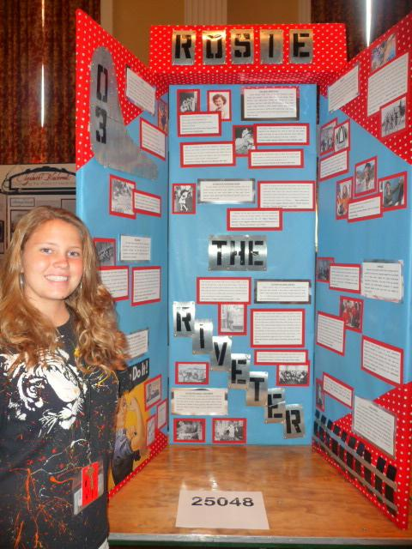
Fit to Design
Use colors & designs which begin focus to the photos.
Layout can flow a creative layout to highlight message.
‹#›

Slide 32
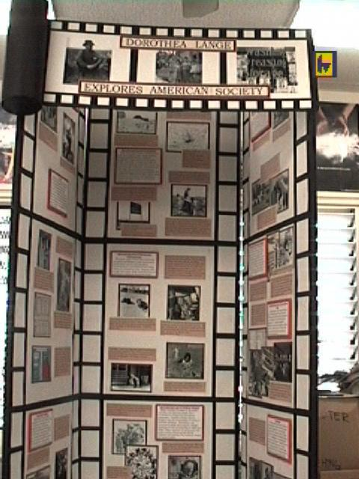
Title Placement
Avoid taking up to much space.
Put somewhere besides on the three panels.
Or incorporate within the project design.
‹#›

Slide 33
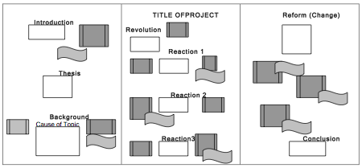
Display Layout Example
‹#›

Slide 34
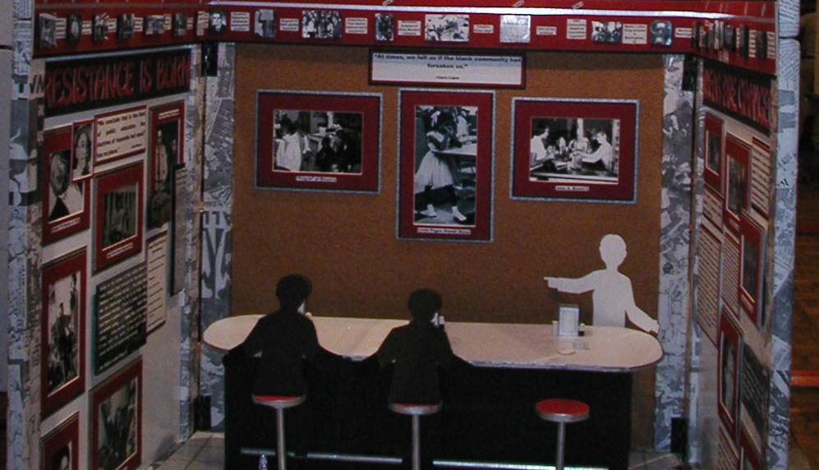
4. VISUAL DESIGN
Telling the story from a distance.

Slide 35
Color Selection
Choose 3 main colors to tell story.
Analysis Statements
Evidence
Background
‹#›

Slide 36
‹#›

Slide 37
‹#›

Slide 38
‹#›

Slide 39
‹#›

Slide 40
‹#›

Slide 41
‹#›

Slide 42
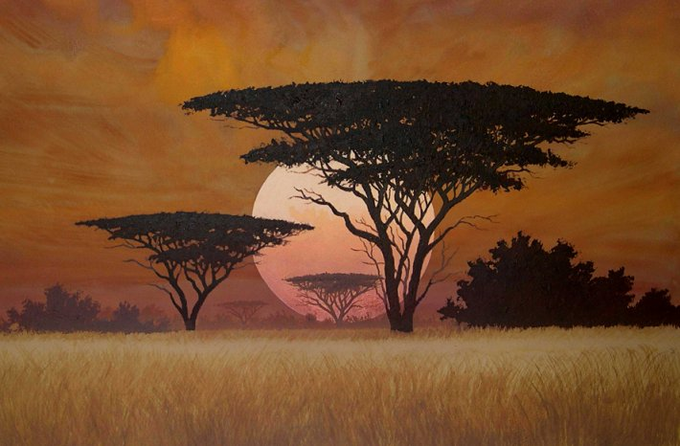
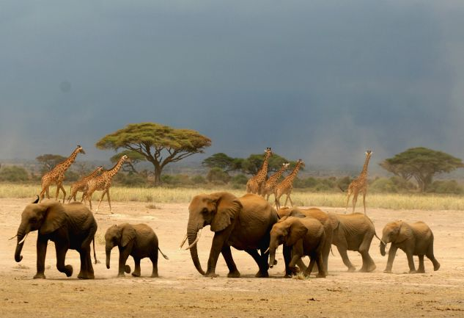
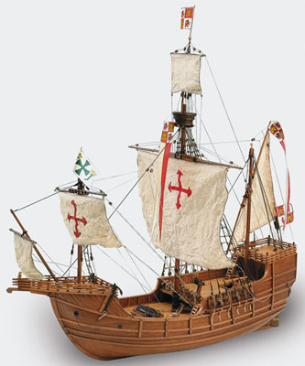
‹#›

Slide 43
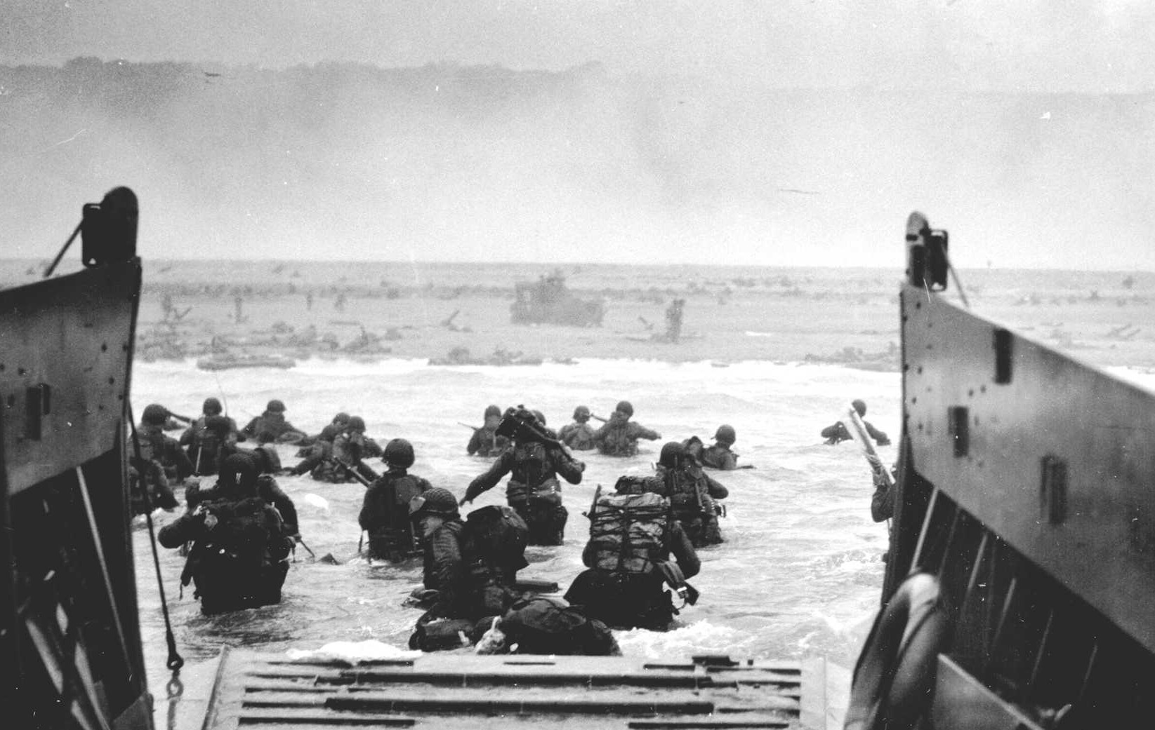
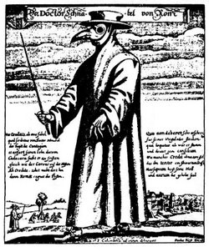
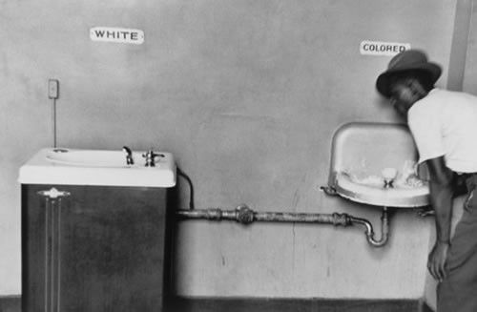
‹#›

Slide 44
Color Combinations
Combining colors to tell story. For example...
Nationality
Gender
Disputes
Environment
‹#›

Slide 45
‹#›

Slide 46
‹#›

Slide 47
‹#›

Slide 48
‹#›

Slide 49
‹#›

Slide 50
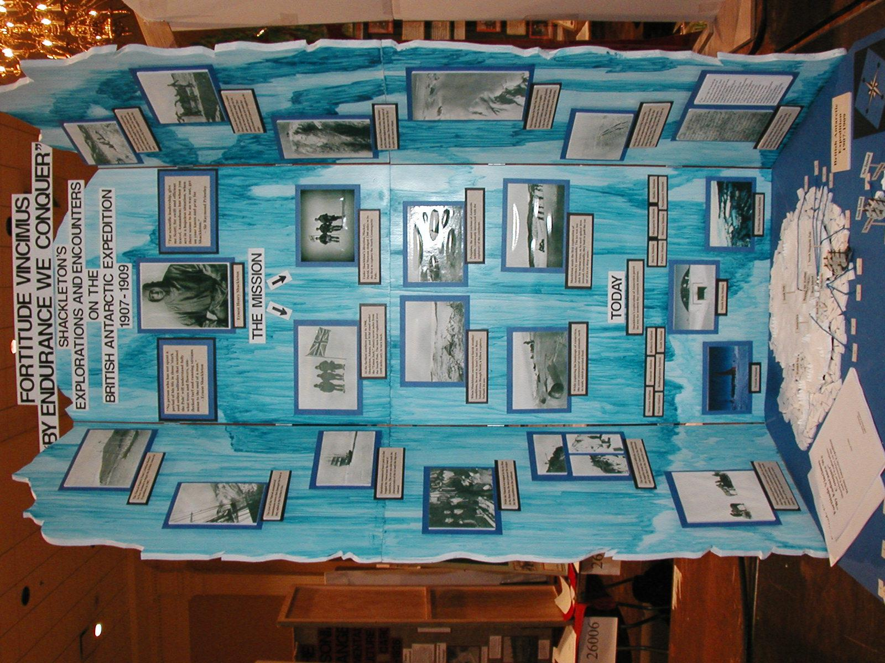
Display Design
Create a design to tell the story from a distances.
‹#›

Slide 51
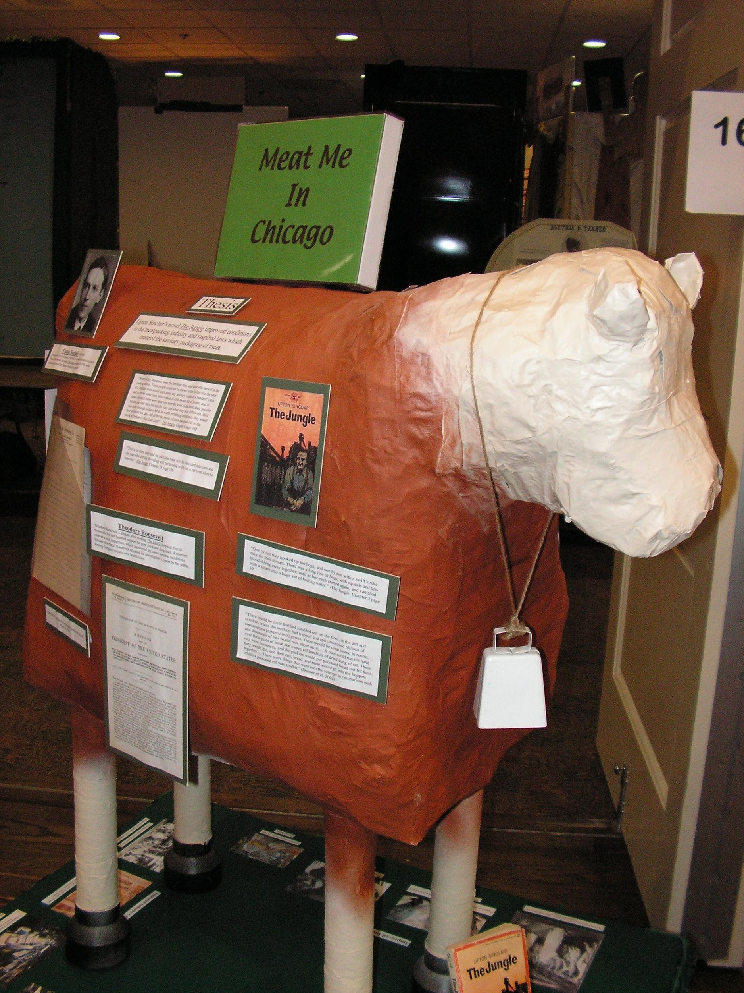
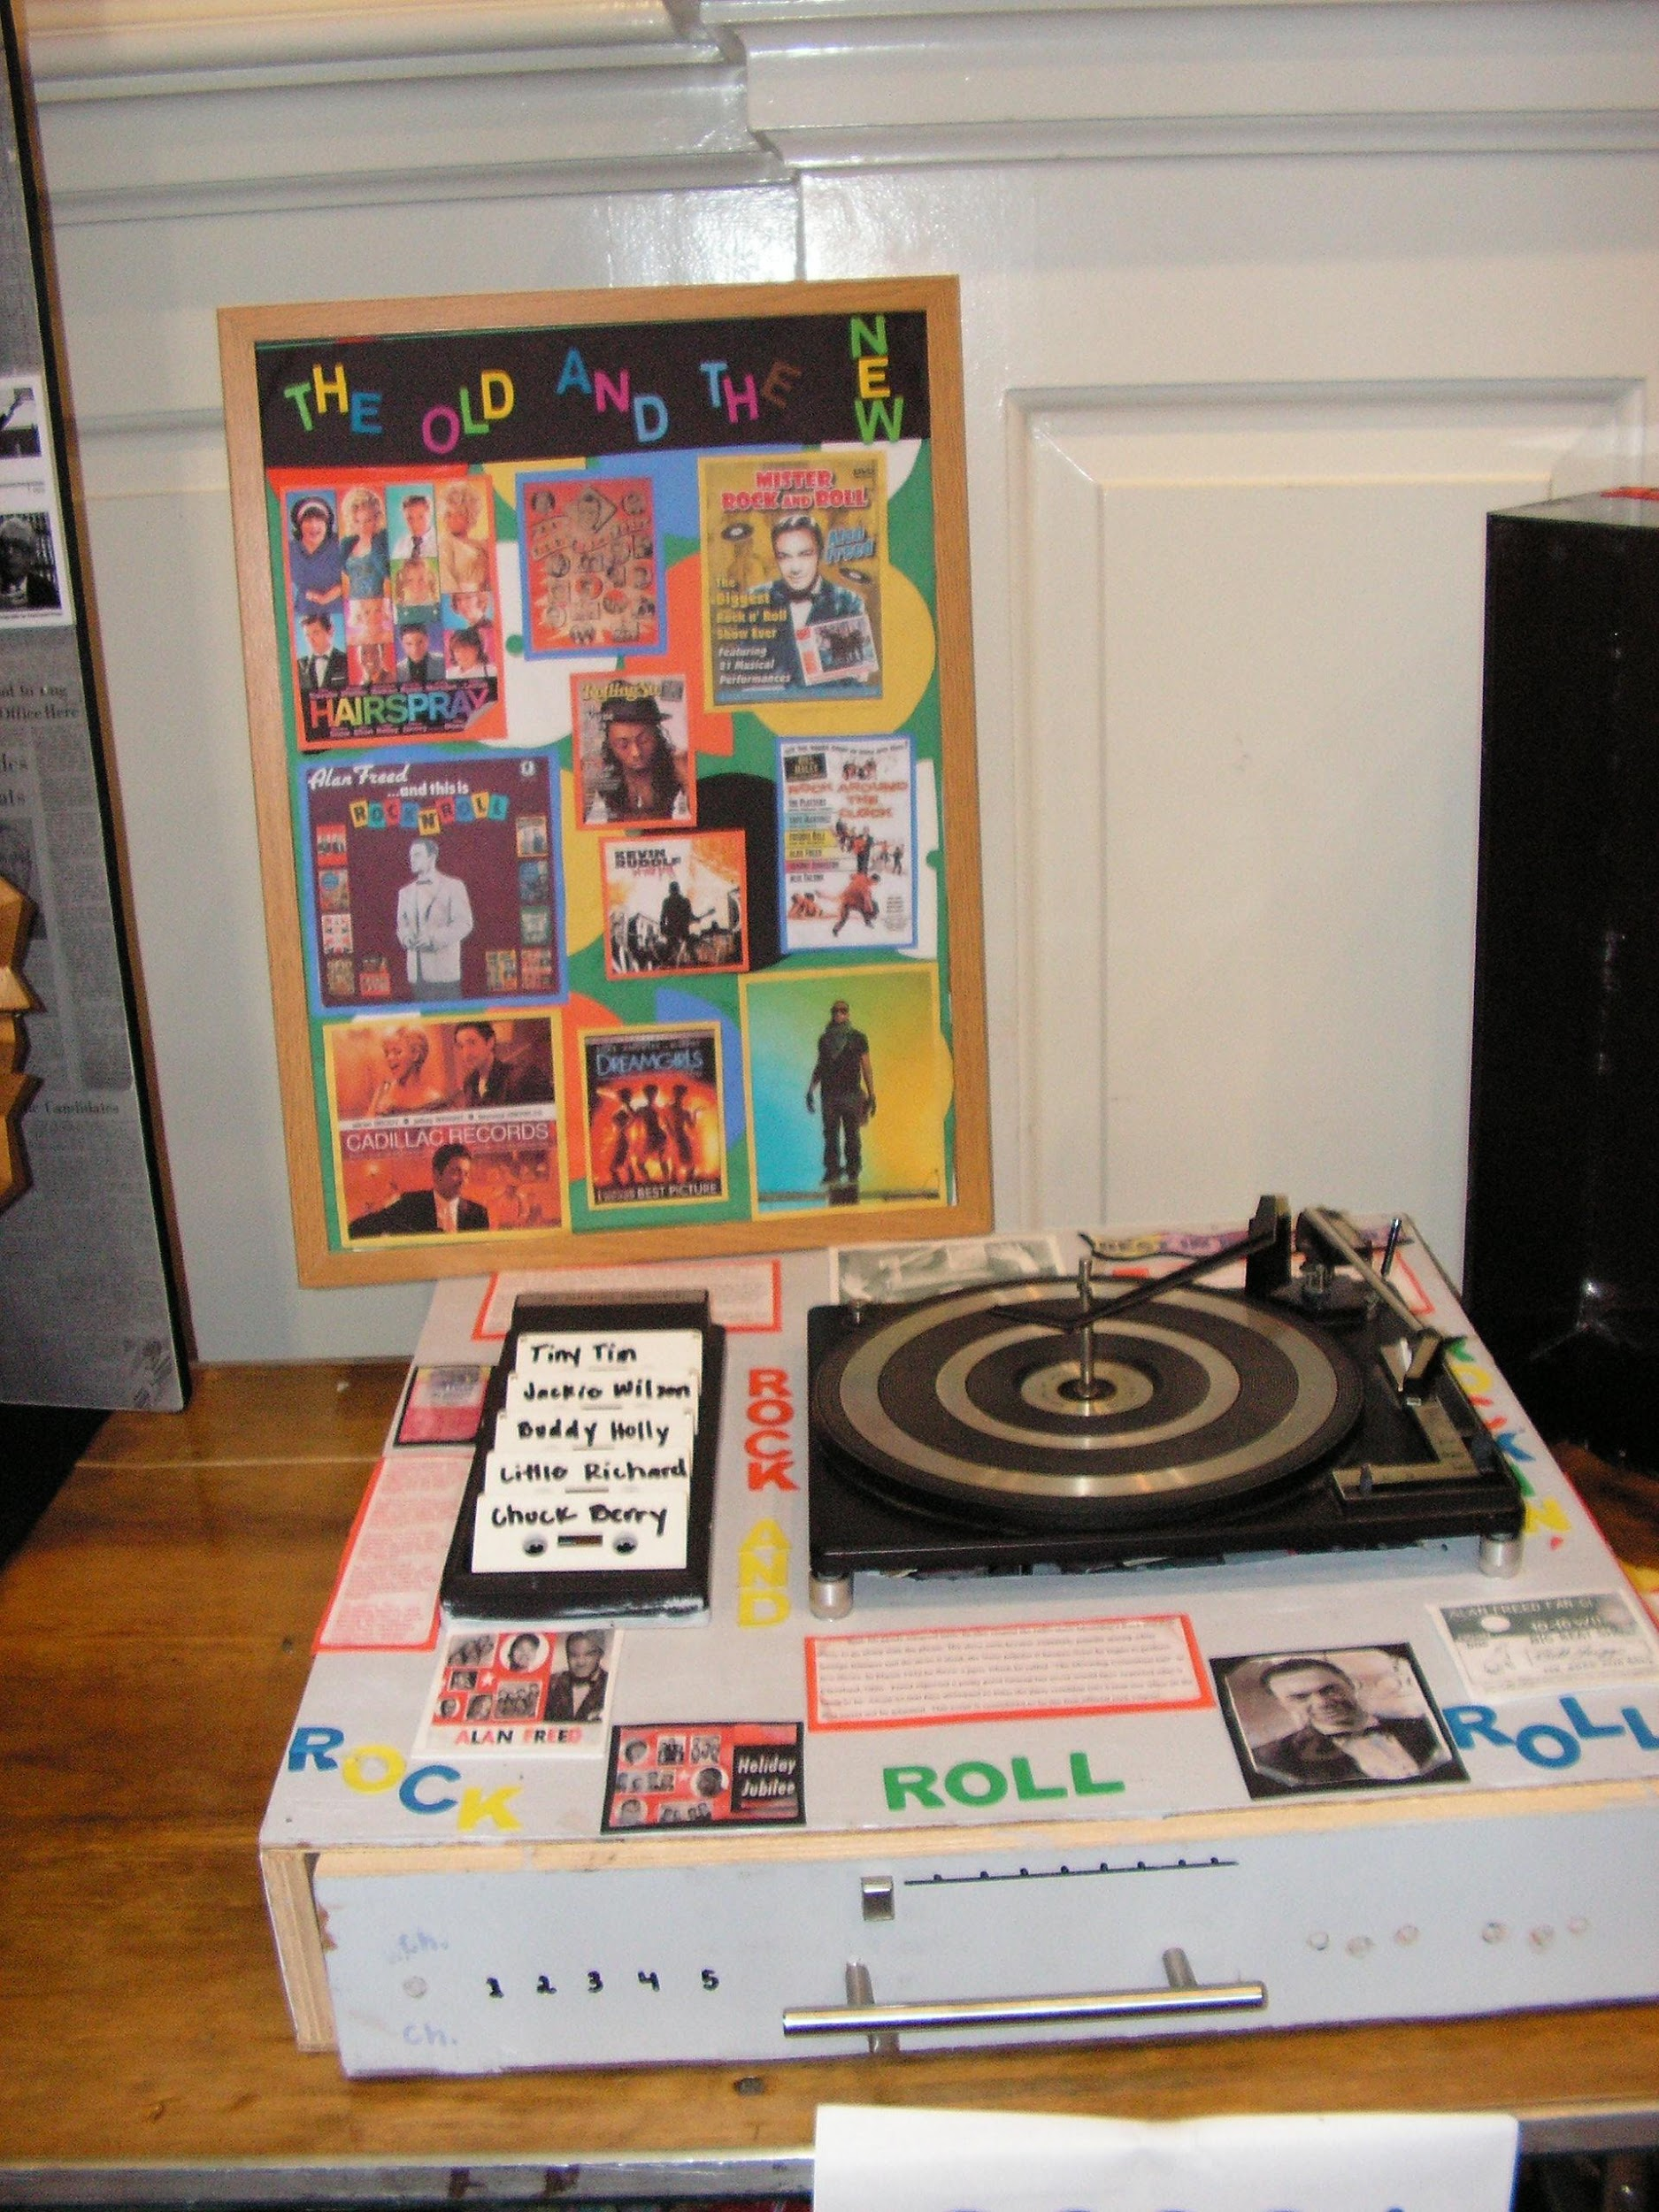
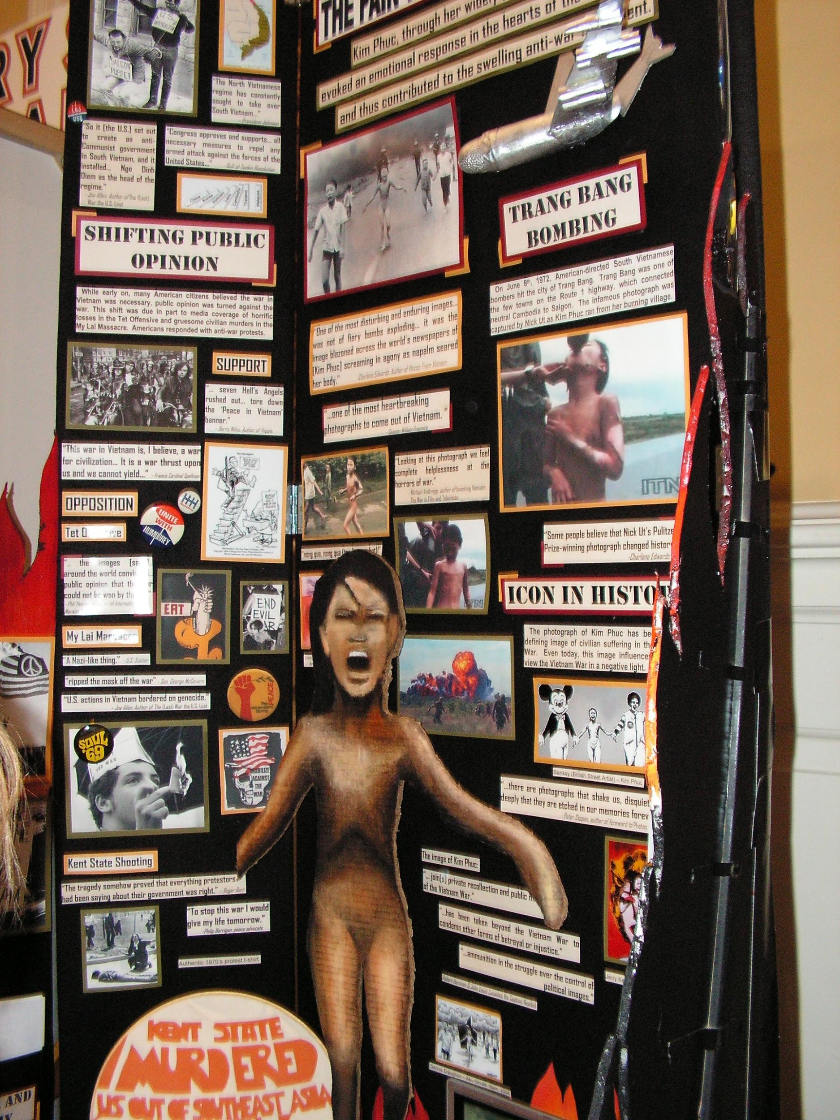
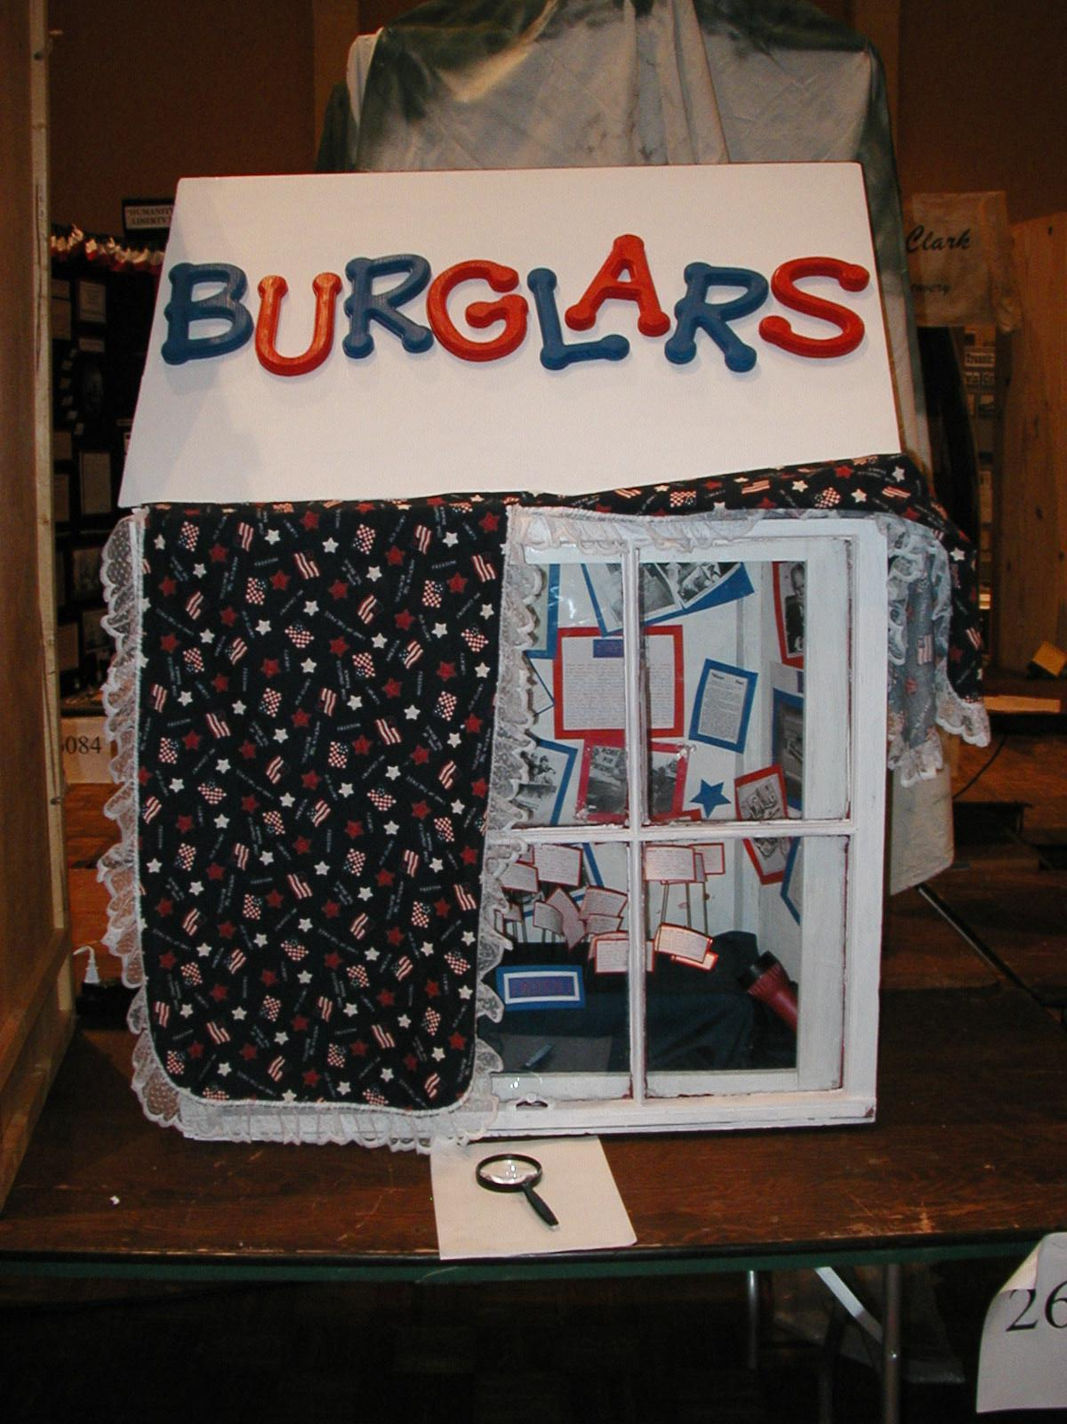
5. DISPLAY DON’TS

Slide 52
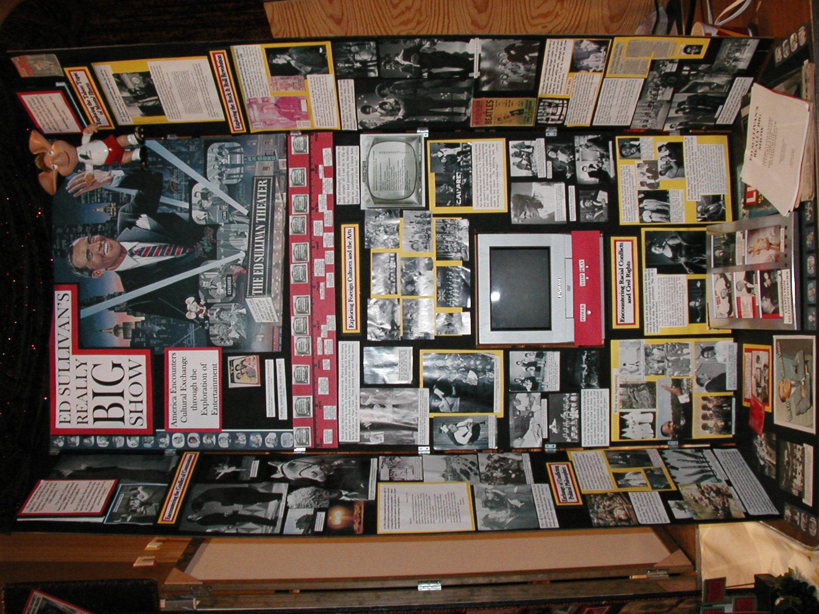
Clutter Boards
Don’t put everything on
Edit, edit, edit
‹#›

Slide 53
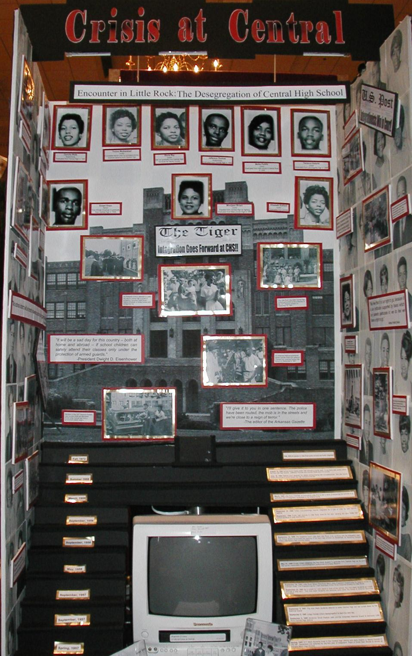
Detail Background
If you background is to detailed, you can’t tell what it is.
Plan how the background will highlight the evidence, not distract.
‹#›

Slide 54
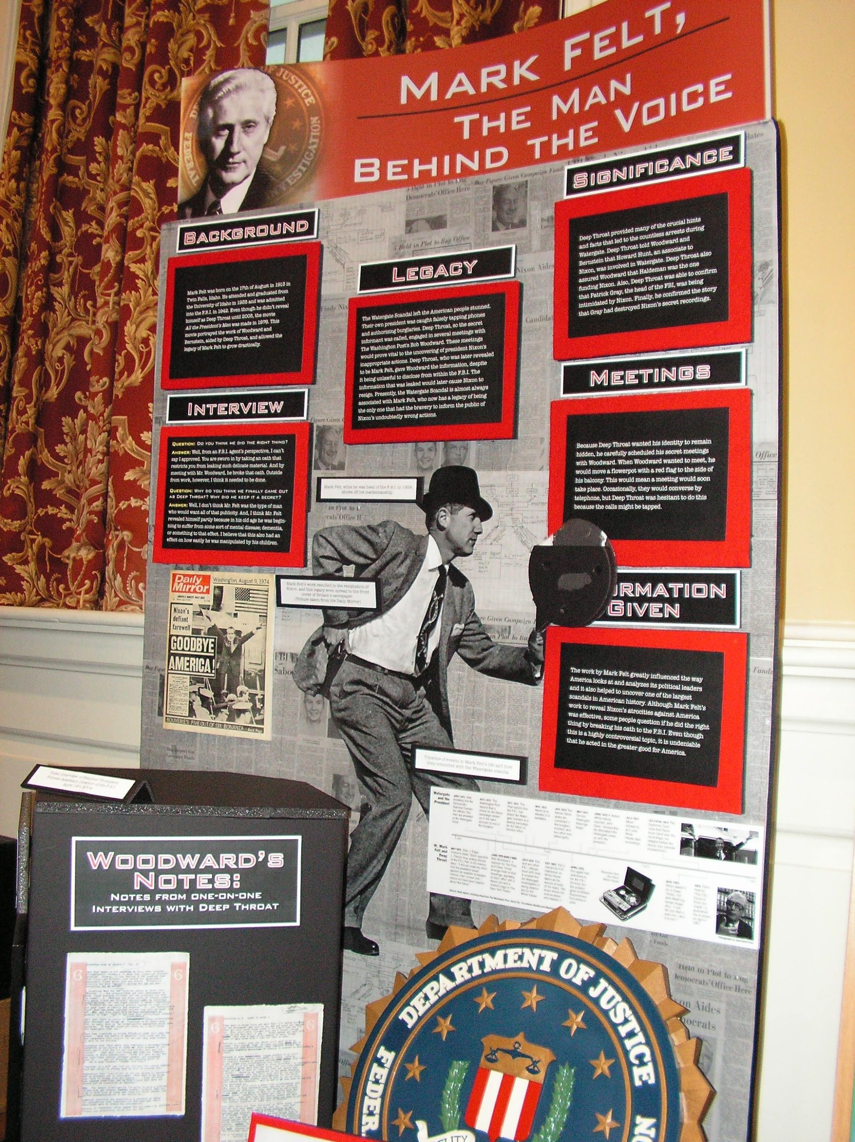
Graphic Overkill
To much detail confuses the reader.
‹#›

Slide 55
Forget Evidence
The most important part of the display in the analysis statements and evidence.
Don’t forget the evidence.
‹#›

Slide 56
Recreate History
This is not a model building competition.
Judges are looking to primary source evidence, not sources created by students.
‹#›

Slide 57
Waste Space
Use all available space without cluttering.
Gimmick boards limit the evidence provided.
‹#›

Slide 58
Micro Print
It should be possible to read a display in 4 minutes.
Make font and pictures visible at 4 feet.
‹#›

Slide 59
National Winners & Qualifiers

