Slide 1
Noodle Tools
Registration
STUDENT

Slide 2
Student Registration
Register for a Mililani NHD Student Account at bit.ly/nhdnoodletools
School Username: (ask teacher)
School Password: (ask teacher)

Slide 3
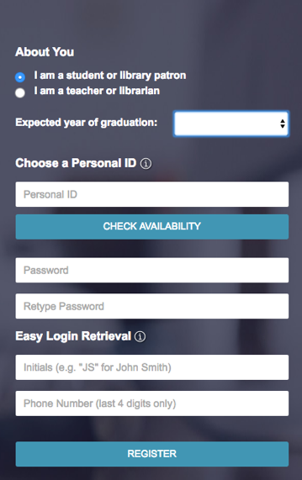
Student Registration
Complete individual student information
Choose “I am a student patron”
Remember info as teachers will not have access to your information

Slide 4
Registration Complete
After you register, you will see the Projects screen.

Slide 5
Creating NHD Project

Slide 6
Starting NHD Project (New project)
On the Projects screen, click New project

Slide 7
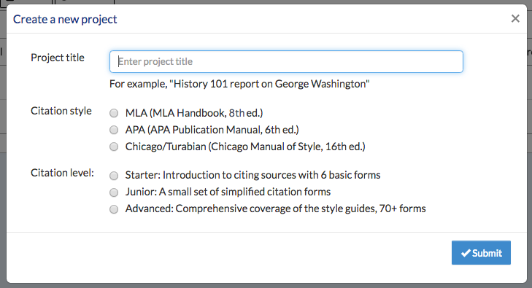
Create a
NHD Project
2. On the ‘Create a New Project’ screen that pops up, enter a name for your project
LastName NHD2016 eg. Murphy NHD2016
Than select the MLA citation style and Advanced level. Click Submit.
NOTE: Once you create a project, you will be able to switch seamlessly between styles and levels. So what you set up now can be changed later with one click.

Slide 8
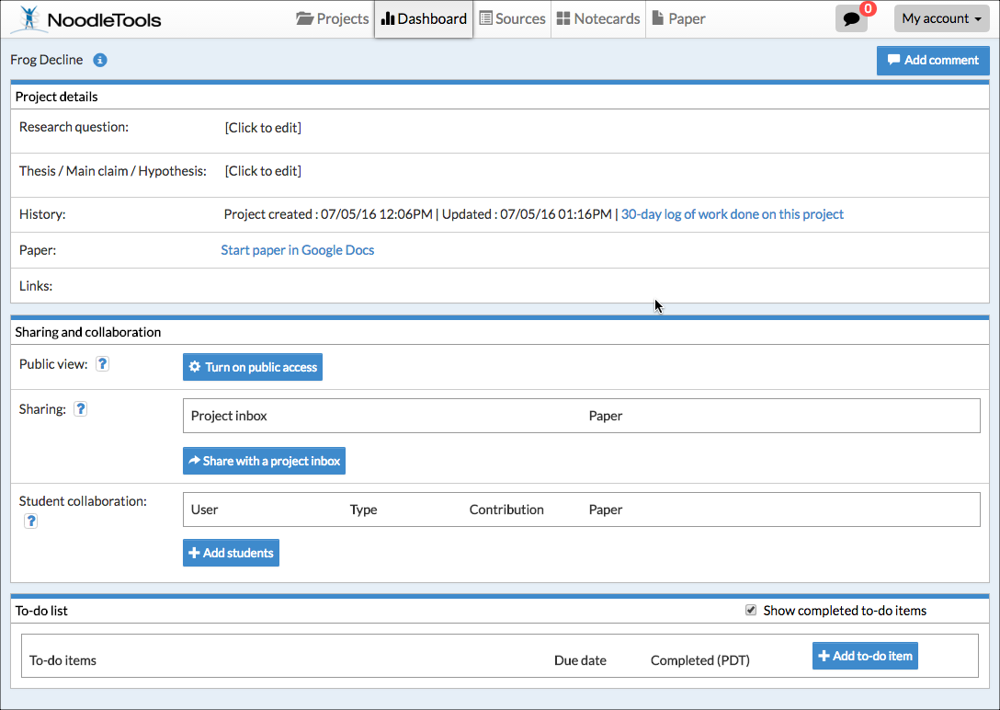
NHD Project Description
& Sharing with Teacher
Dashboard
Project details
1. Research Question: Taking a Stand in History: Action & Change
Sharing and collaboration
2. Sharing: Click on blue box ‘Share with a project inbox’
(Use Project inbox title provided by teacher and First & Last Name)

Slide 9
Creating NHD Source Cards

Slide 10
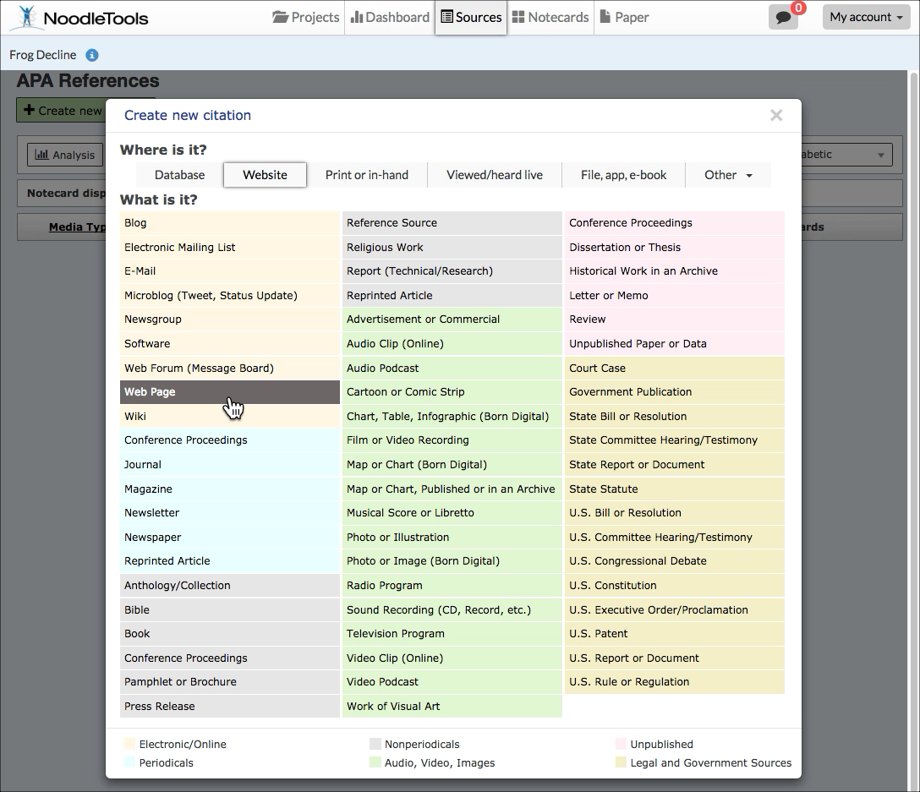
NHD Sources
Click on the Sources screen
Click Create new citation and select the best match for your source from the choices given.

Slide 11
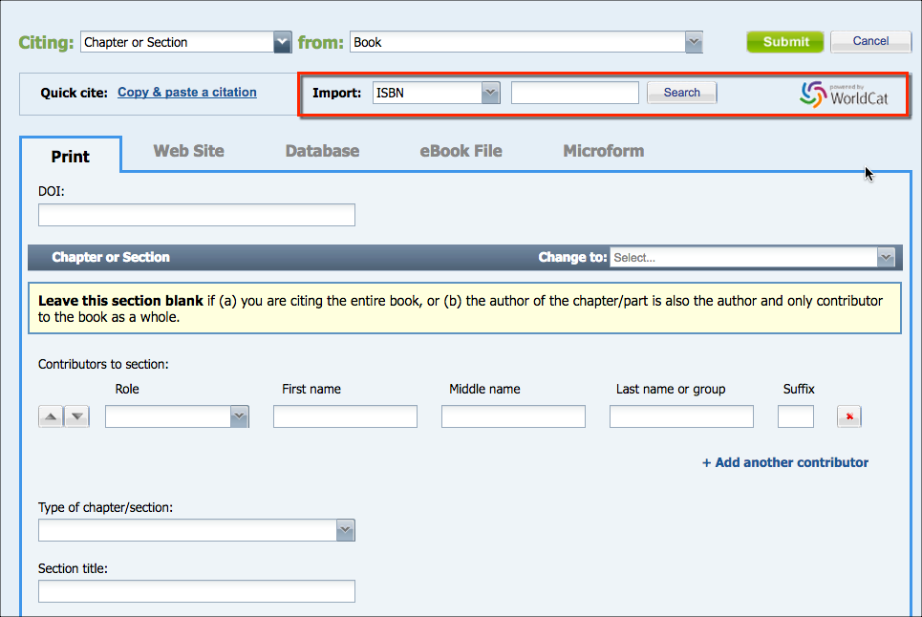
NHD Sources
Fill in the citation form with information about your source.
After you finish entering information about your source, click Submit to save your new citation.
If your source is a book, you can locate the book in WorldCat (via an ISBN number or title/author search) and it will automatically fill in the form with the book's details, checked and revised for accuracy by NoodleTools.

Slide 12
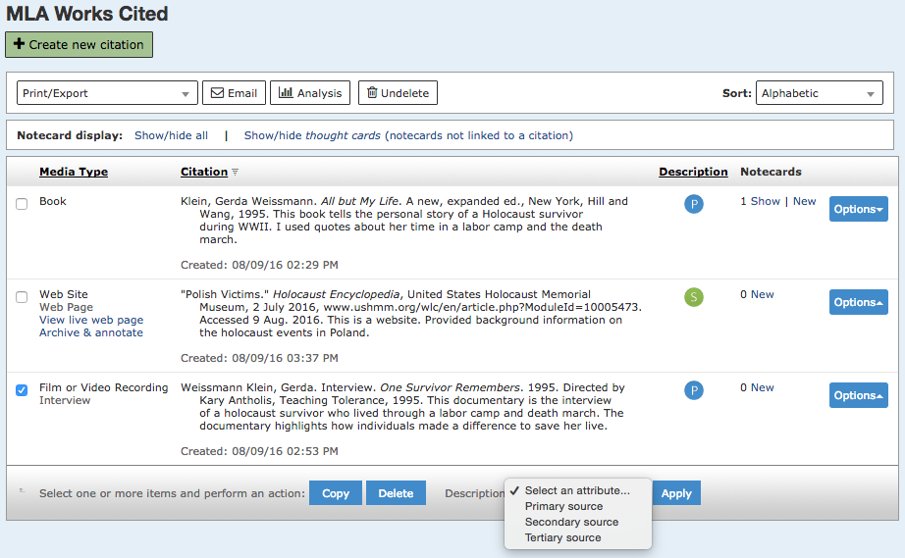
Label Source Type
To label if it is secondary or primary, check the sources you want to identify.
Then use drop down menu to select an attribution - Primary or Secondary and click apply.

Slide 13
Creating NHD Note Cards

Slide 14
Creating a Notecards
Click Notecards in the navigation bar at top.
On the Notecard Tabletop, click New.

Slide 15
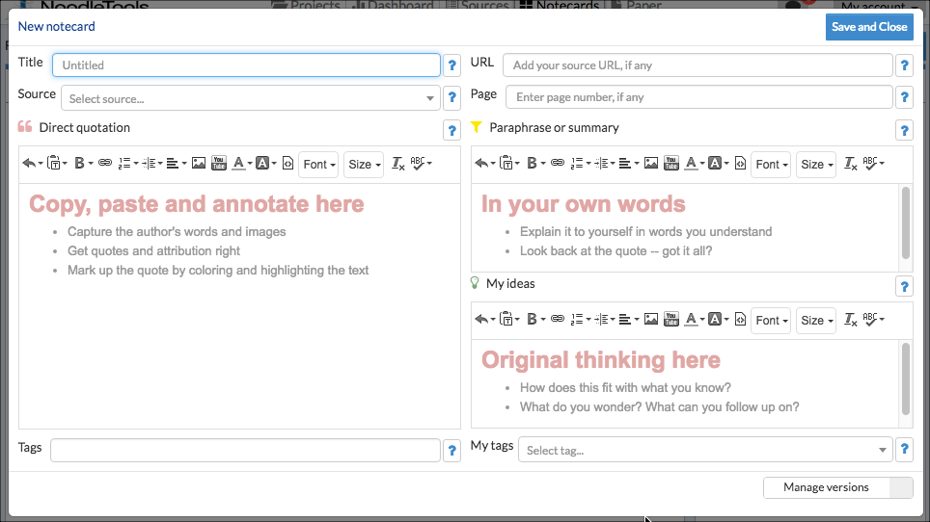
NHD Sources
Input notes about your source.
Title: Use SPICE key words
Source: Link to source
Notes: (Direct quote, paraphrase, or analysis)
Tags: Paragraph #s, SPICE
Your notecard gets saved automatically as you add information. When you are done, click Save and Close to save your final changes and close the window.

Slide 16
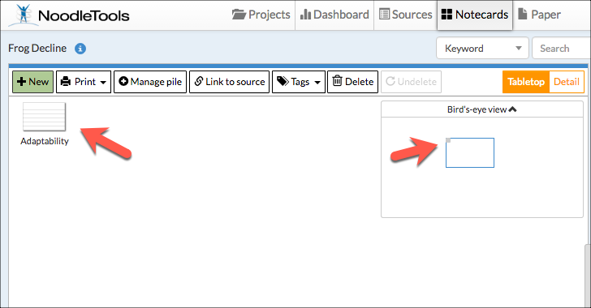
Notecards Sorted
Once you've created multiple notecards, you can pile them according to ‘Questions to Explore’ handout.
Drag a notecard and drop it on another notecard to create a new pile, or use the Manage pile option above the tabletop to manage existing and create new piles with selected notecards.
Notecard piles become the basis of organization within the Outline panel next to the Notecard Tabletop.

